Slide 1
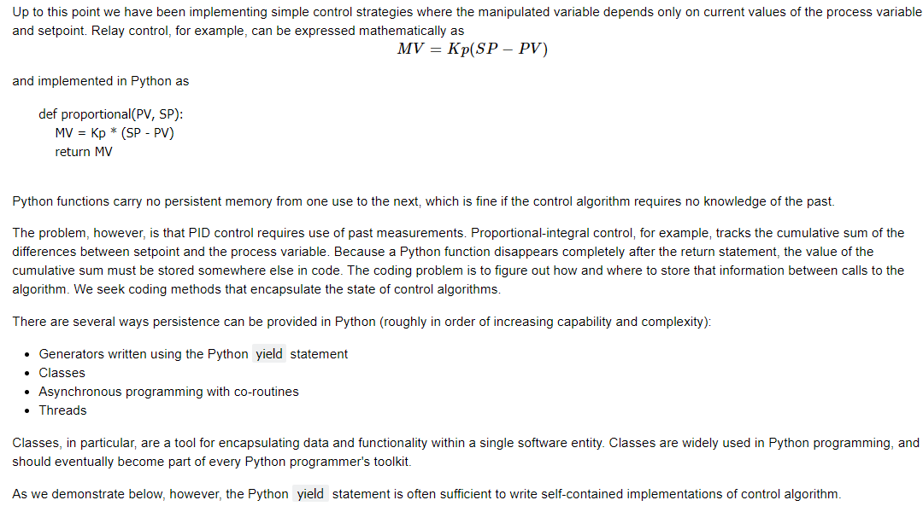
Process Modeling : Implementing PID Controllers with Python Yield Statement

Slide 2
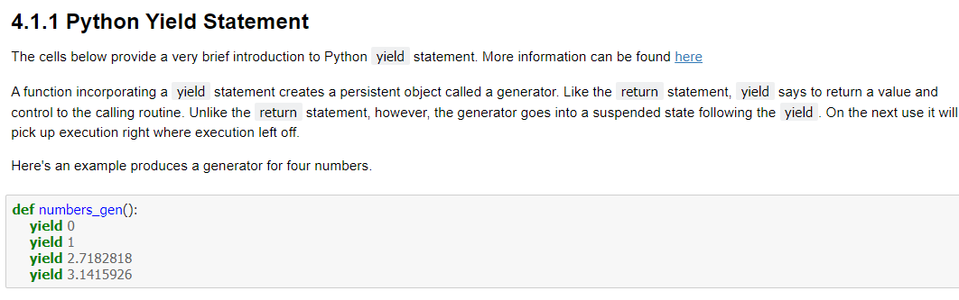
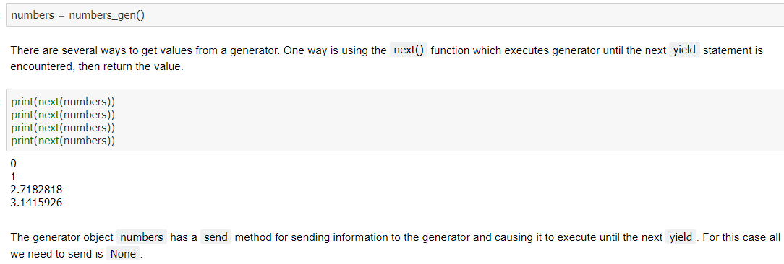
Process Modeling : Implementing PID Controllers with Python Yield Statement

Slide 3
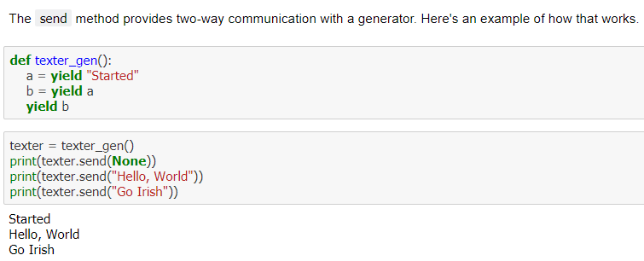
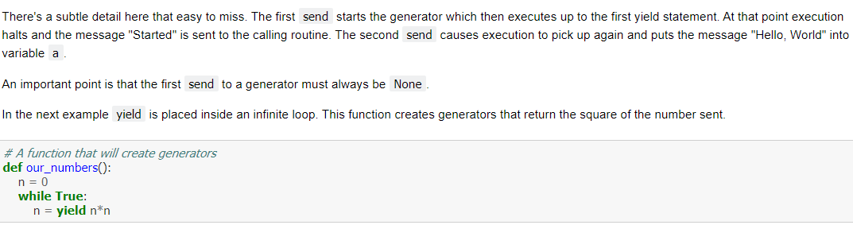
Process Modeling : Implementing PID Controllers with Python Yield Statement

Slide 4
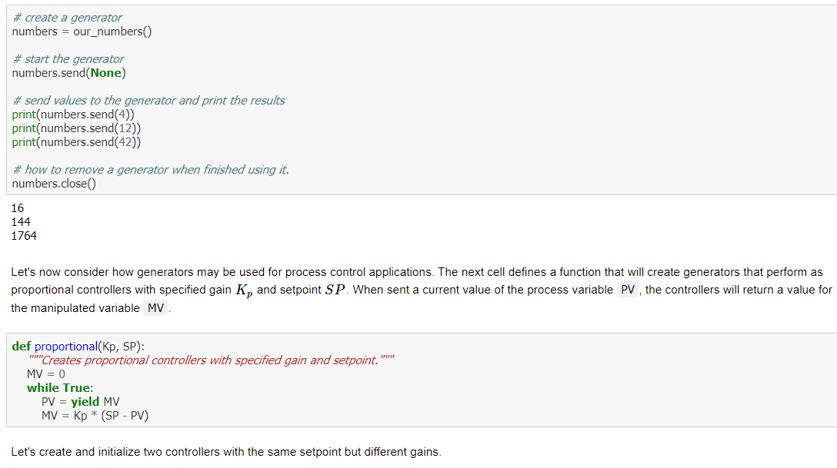
Process Modeling : Implementing PID Controllers with Python Yield Statement

Slide 5
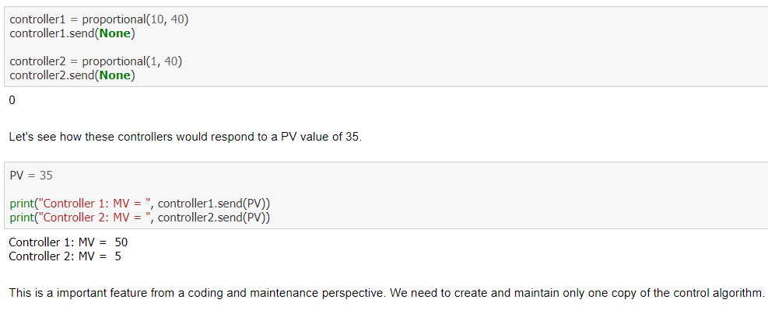
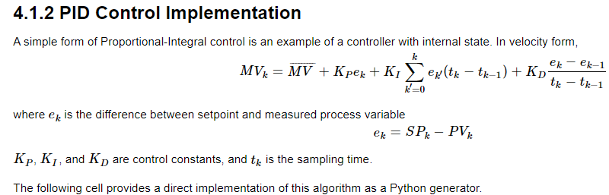
Process Modeling : Implementing PID Controllers with Python Yield Statement

Slide 6
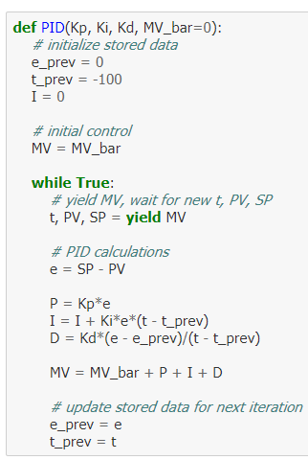
Process Modeling : Implementing PID Controllers with Python Yield Statement

Slide 7
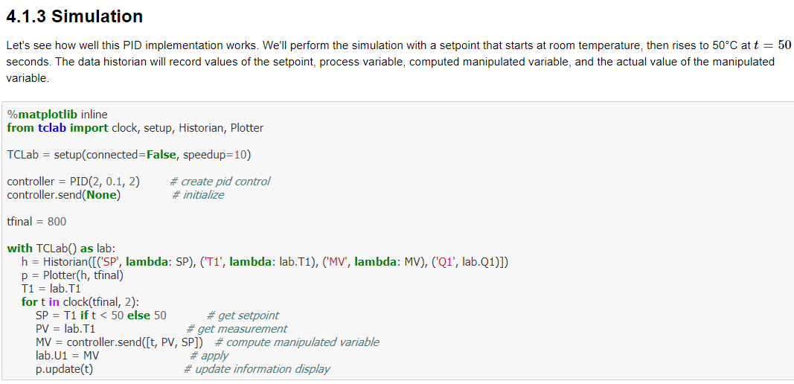
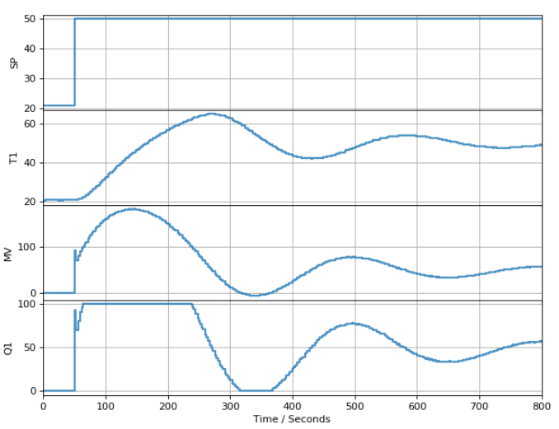
Process Modeling : Implementing PID Controllers with Python Yield Statement

Slide 8
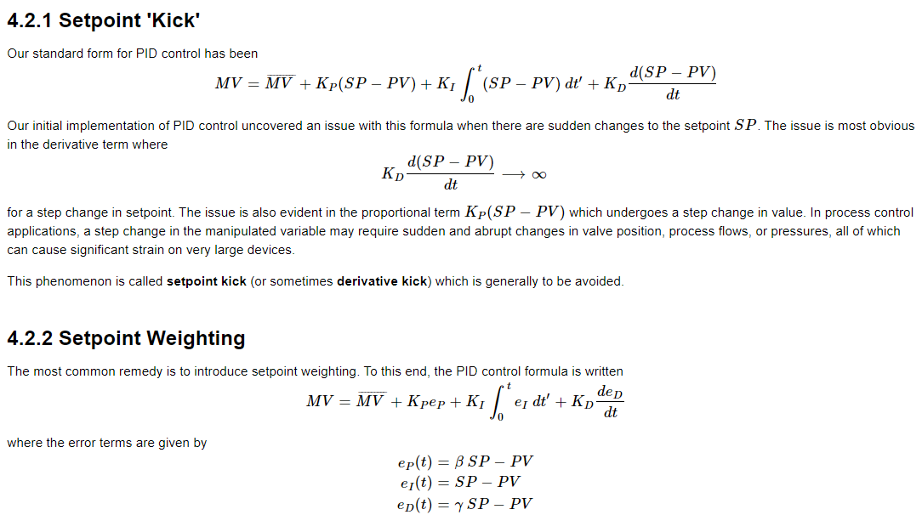
Process Modeling : PID Control with Setpoint Weighting

Slide 9
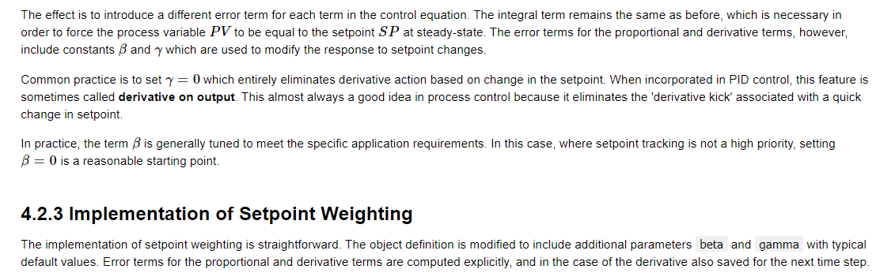
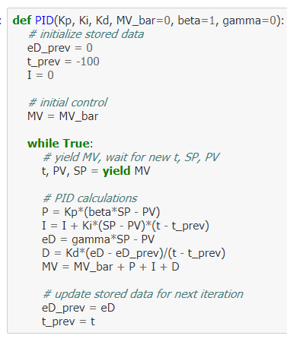
Process Modeling : PID Control with Setpoint Weighting

Slide 10

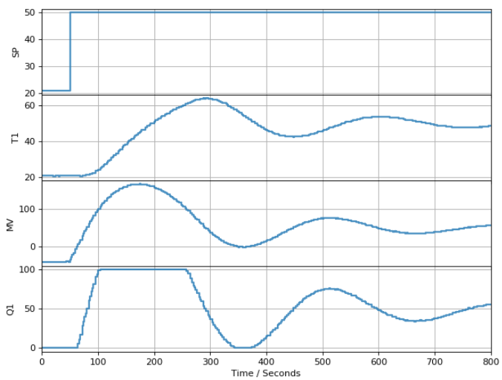
Process Modeling : PID Control with Setpoint Weighting

Slide 11
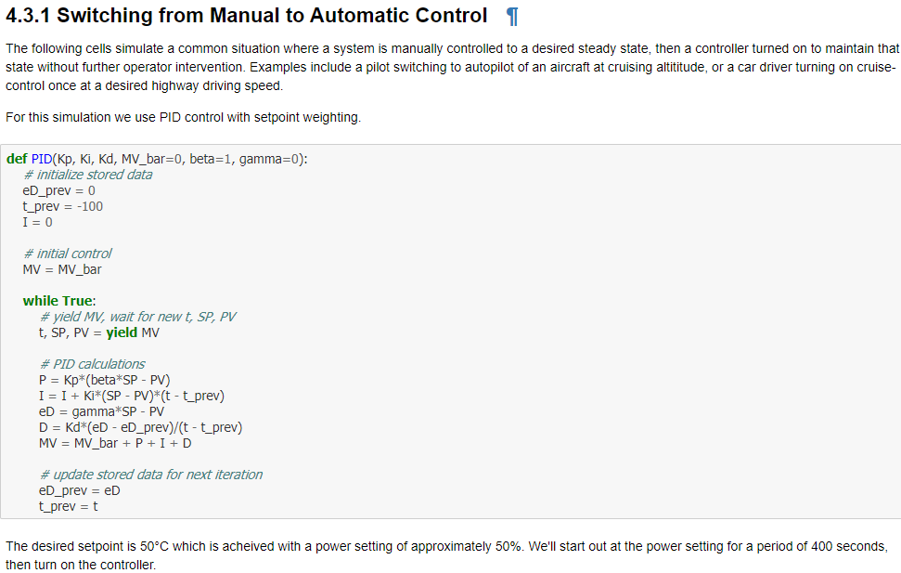
Process Modeling : PID Control with Bumpless Transfer

Slide 12
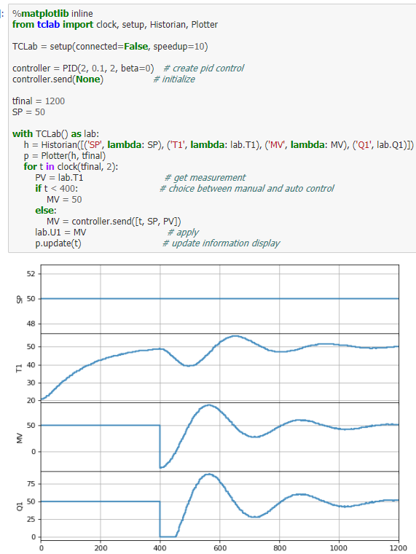
Process Modeling : PID Control with Bumpless Transfer

Slide 13
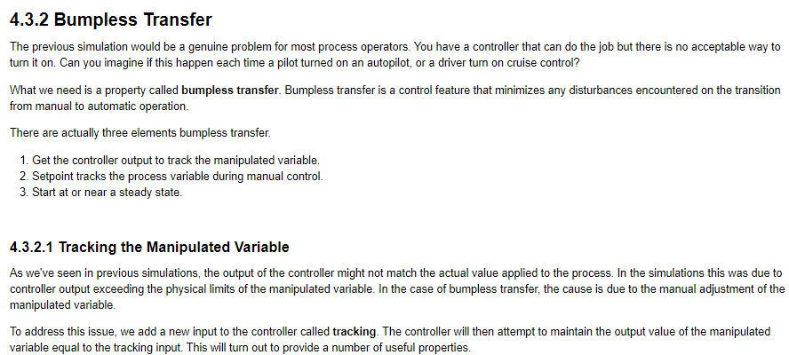
Process Modeling : PID Control with Bumpless Transfer

Slide 14
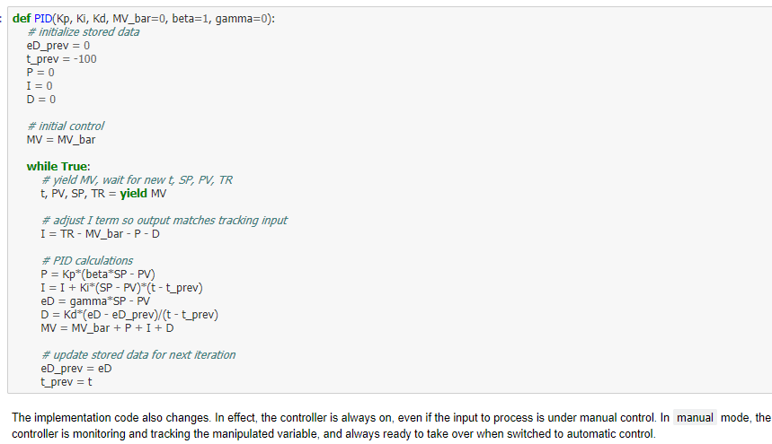
Process Modeling : PID Control with Bumpless Transfer

Slide 15
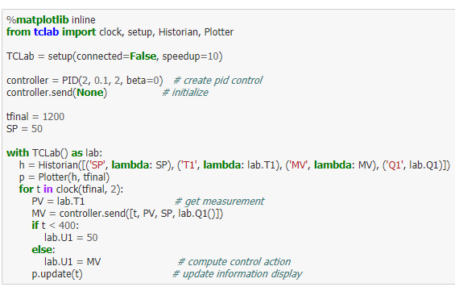
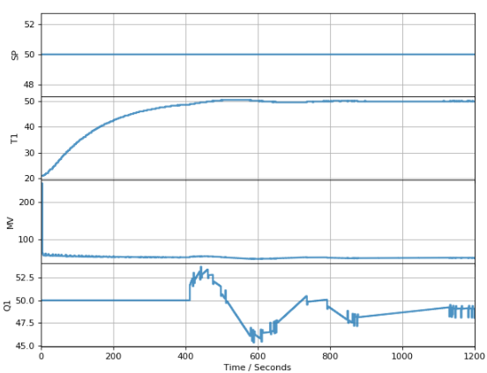
Process Modeling : PID Control with Bumpless Transfer

Slide 16
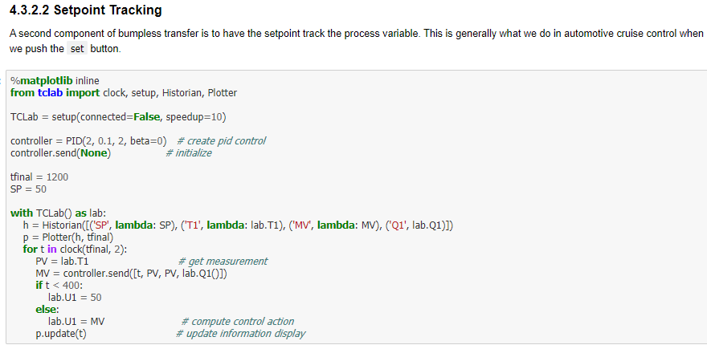
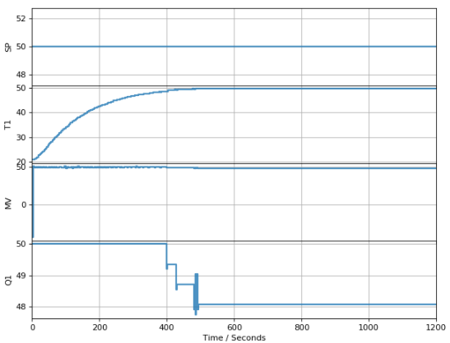
Process Modeling : PID Control with Bumpless Transfer

Slide 17
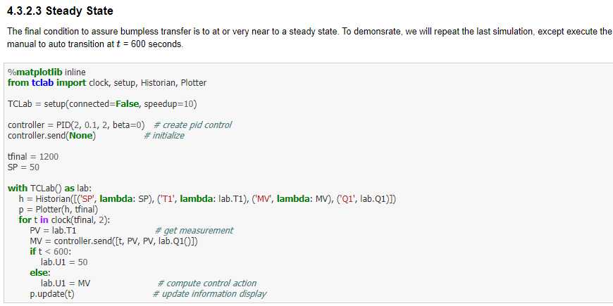
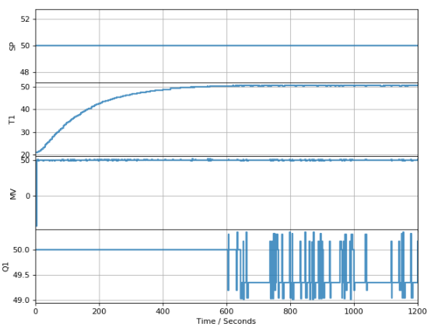
Process Modeling : PID Control with Bumpless Transfer

Slide 18
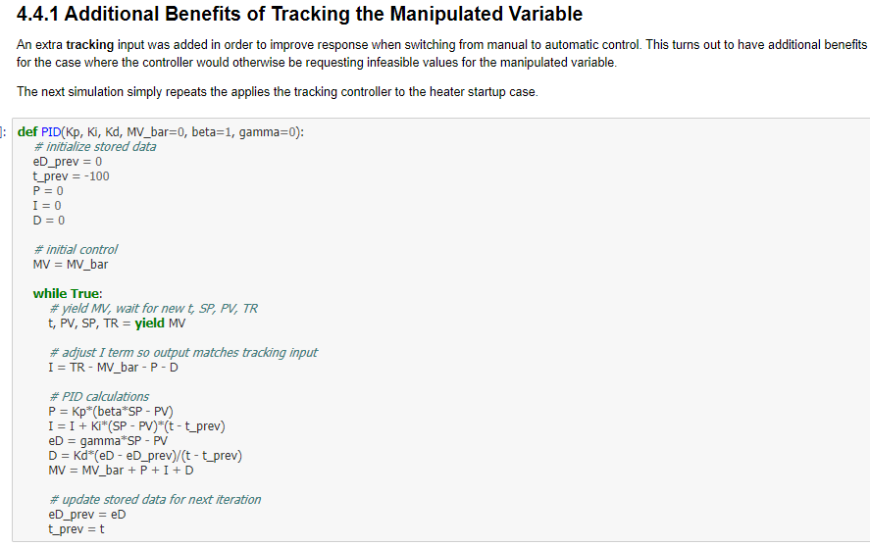
Process Modeling : PID Control with Anti-Reset-Windup

Slide 19
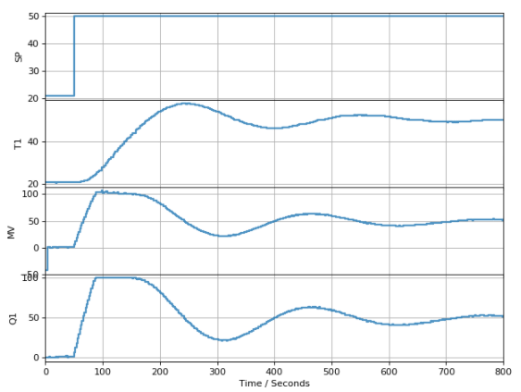
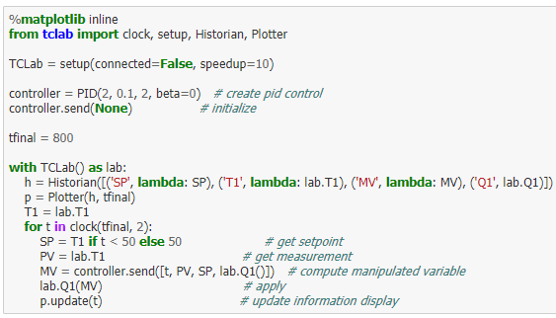
Process Modeling : PID Control with Anti-Reset-Windup

Slide 20
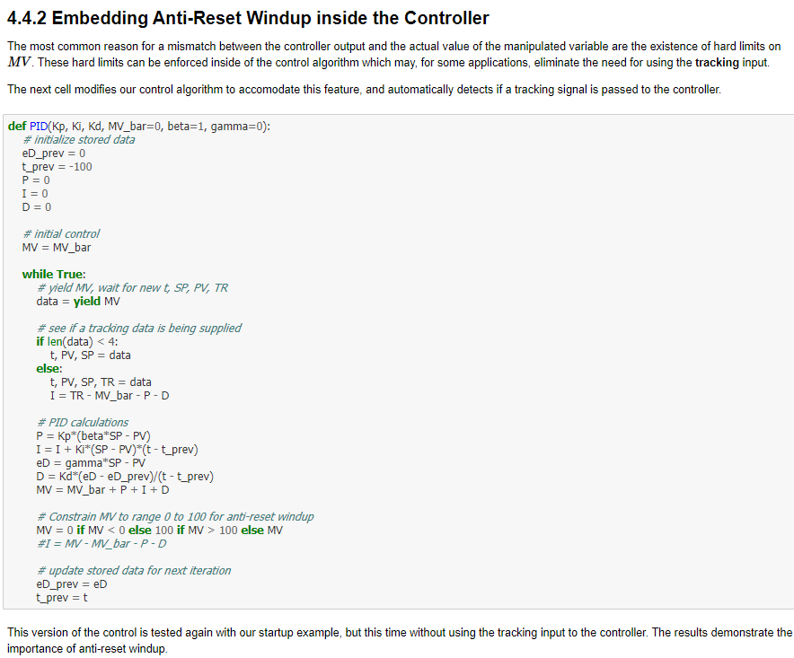
Process Modeling : PID Control with Anti-Reset-Windup

Slide 21
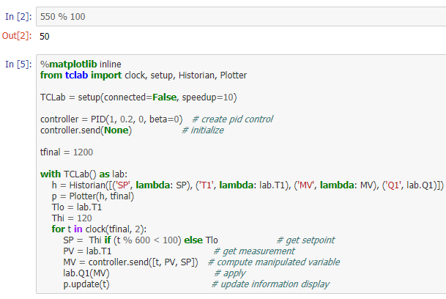
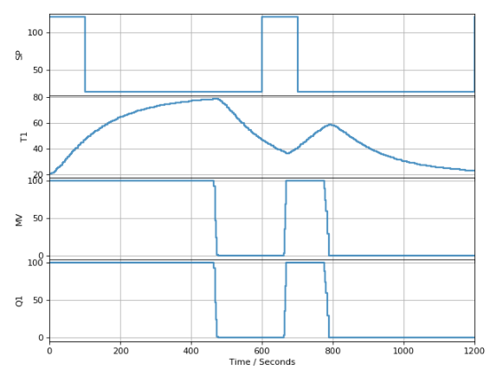

Process Modeling : PID Control with Anti-Reset-Windup

Slide 22
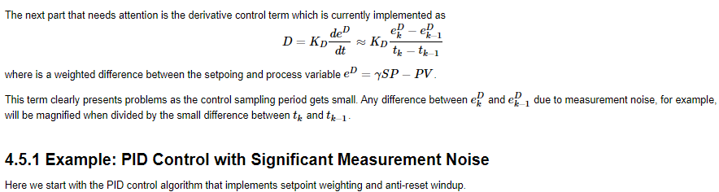
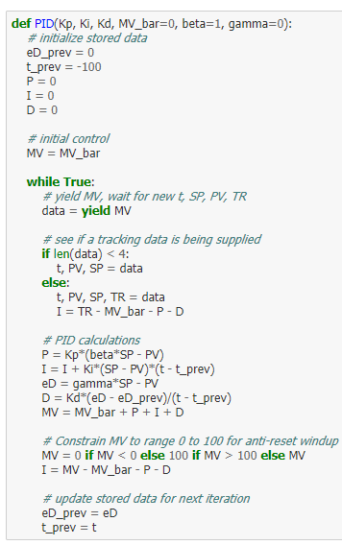
Process Modeling : Realizable PID Control

Slide 23
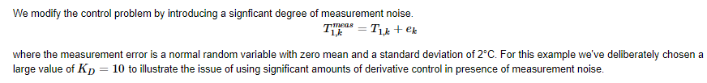
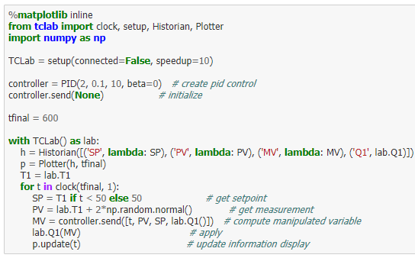
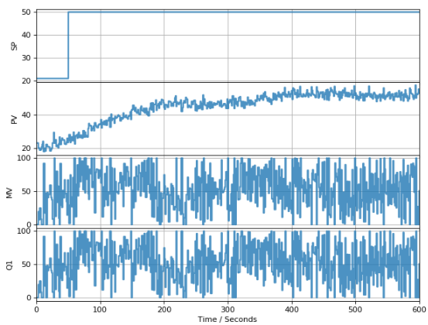
Process Modeling : Realizable PID Control

Slide 24
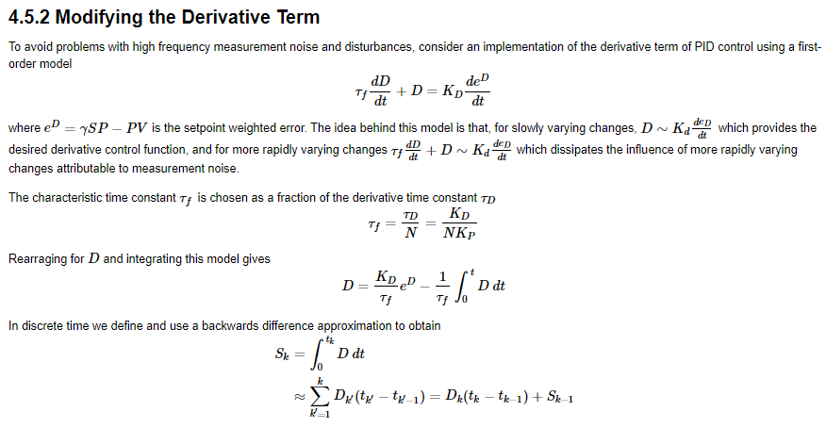
Process Modeling : Realizable PID Control

Slide 25
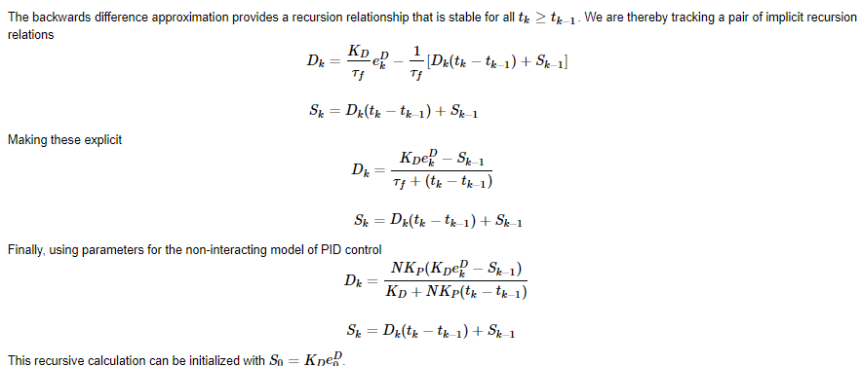
Process Modeling : Realizable PID Control

Slide 26
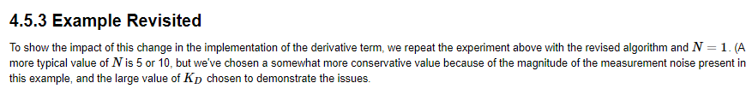
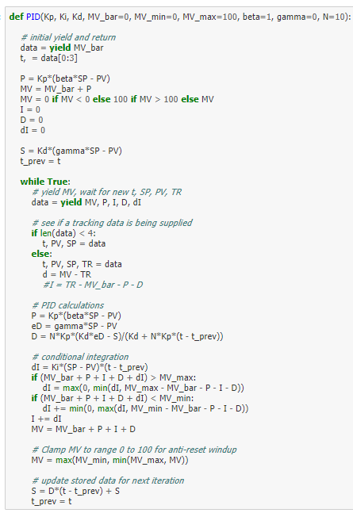
Process Modeling : Realizable PID Control

Slide 27
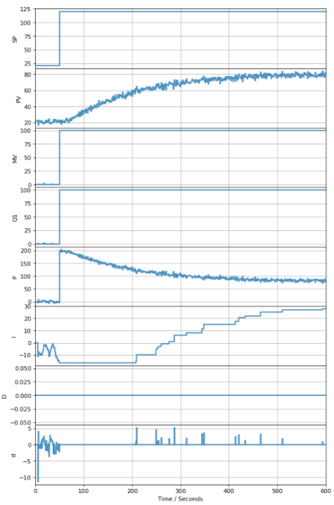
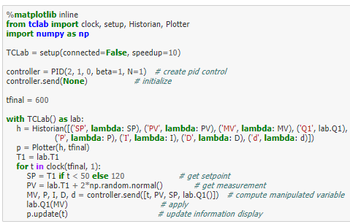
Process Modeling : Realizable PID Control

Slide 28
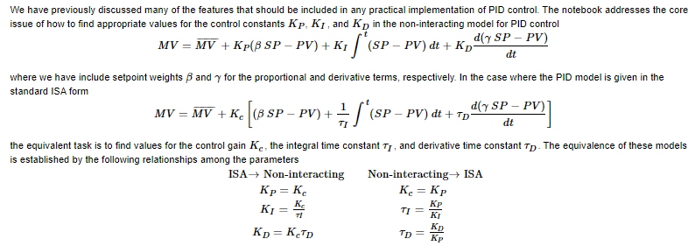
Process Modeling : PID Controller Tuning

Slide 29
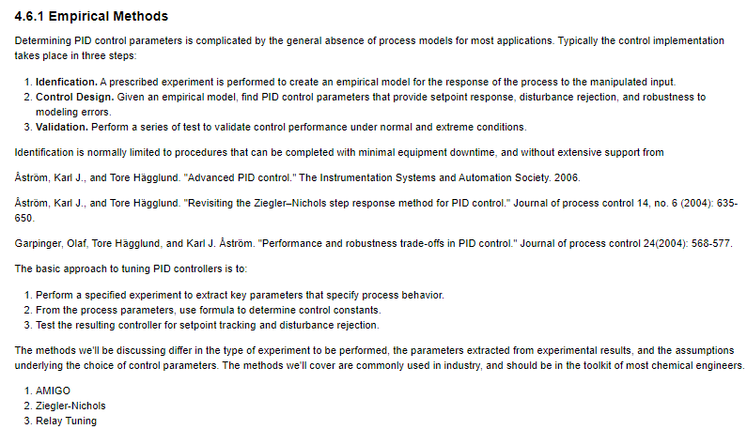
Process Modeling : PID Controller Tuning

Slide 30
Process Modeling : PID Controller Tuning

Slide 31
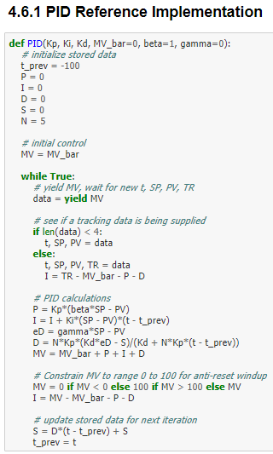
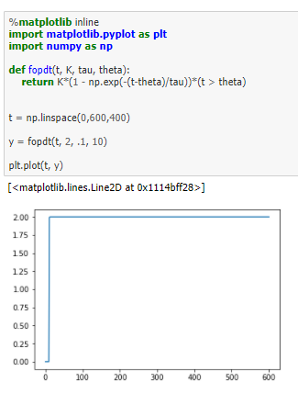
Process Modeling : PID Controller Tuning

Slide 32
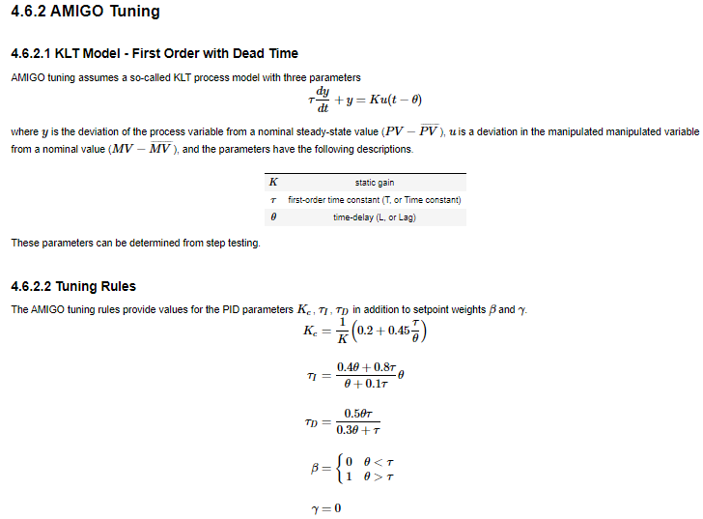
Process Modeling : PID Controller Tuning

Slide 33
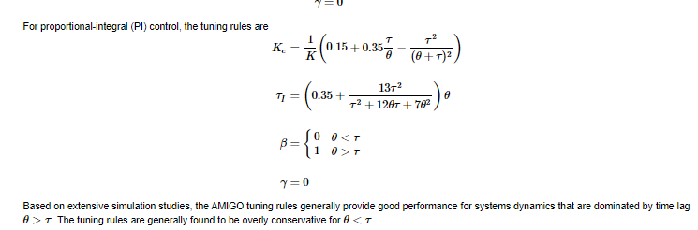
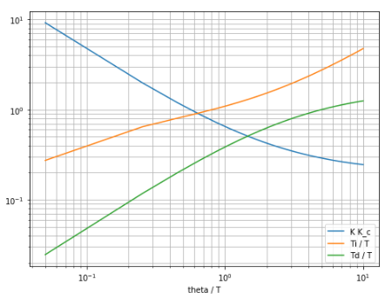
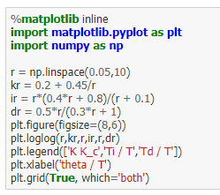
Process Modeling : PID Controller Tuning

Slide 34


Process Modeling : PID Controller Tuning

Slide 35


Process Modeling : PID Controller Tuning

Slide 36

Process Modeling : PID Control - Laboratory

Slide 37

Process Modeling : PID Control - Laboratory

Slide 38

Process Modeling : PID Control - Laboratory

Slide 39



Process Modeling : PID Control - Laboratory

Slide 40

Process Modeling : Implementing PID Control in Nonlinear Simulations

Slide 41

Process Modeling : Implementing PID Control in Nonlinear Simulations

Slide 42

Process Modeling : Implementing PID Control in Nonlinear Simulations

Slide 43

Process Modeling : Implementing PID Control in Nonlinear Simulations

Slide 44



Process Modeling : Implementing PID Control in Nonlinear Simulations

Slide 45


Process Modeling : Implementing PID Control in Nonlinear Simulations

Slide 46


Process Modeling : Implementing PID Control in Nonlinear Simulations

Slide 47


Process Modeling : Implementing PID Control in Nonlinear Simulations

Slide 48


Process Modeling : Implementing PID Control in Nonlinear Simulations

Slide 49

Process Modeling : Implementing PID Control in Nonlinear Simulations

Slide 50

Process Modeling : Implementing PID Control in Nonlinear Simulations

Slide 51



Process Modeling : Implementing PID Control in Nonlinear Simulations

Slide 52



Process Modeling : Implementing PID Control in Nonlinear Simulations

Slide 53


Process Modeling : Implementing PID Control in Nonlinear Simulations

Slide 54

Process Modeling : Implementing PID Control in Nonlinear Simulations

Slide 55

Process Modeling : Implementing PID Control in Nonlinear Simulations

Slide 56

Process Modeling : Implementing PID Control in Nonlinear Simulations

Slide 57

Process Modeling : Implementing PID Control in Nonlinear Simulations

Slide 58

Process Modeling : Interactive PID Control Tuning with Ziegler-Nichols

Slide 59

Process Modeling : Interactive PID Control Tuning with Ziegler-Nichols

Slide 60

Process Modeling : Interactive PID Control Tuning with Ziegler-Nichols

Slide 61

Process Modeling : Interactive PID Control Tuning with Ziegler-Nichols

Slide 62

Process Modeling : Interactive PID Control Tuning with Ziegler-Nichols

Slide 63


Process Modeling : Interactive PID Control Tuning with Ziegler-Nichols

Slide 64

Process Modeling : Interactive PID Control Tuning with Ziegler-Nichols

